Slide 1









Disk Usage Statistics
A utility to analyze a directory’s disk usage and to visualize the result to the user.

Slide 2

Problem Description
Managing disk space can often be tedious. While the “Storage Settings” (found in Windows 10 and above) does show you how much space is being used but only by category.
Choosing a category will point you to parent folders that will open in file explorer when selected, from there you would have to isolate each its subdirectories yourself by selecting “Properties” on the folder/file’s context menu and only then can you see the disk space used.
These programs offer a simple solution of analyzing the disk space of each directory and its subdirectories and displays it in a tree-structure. Furthermore, it displays a brief overview of the drive’s disk usage and lists file types that occupy a given directory (sorted by size).

Slide 3
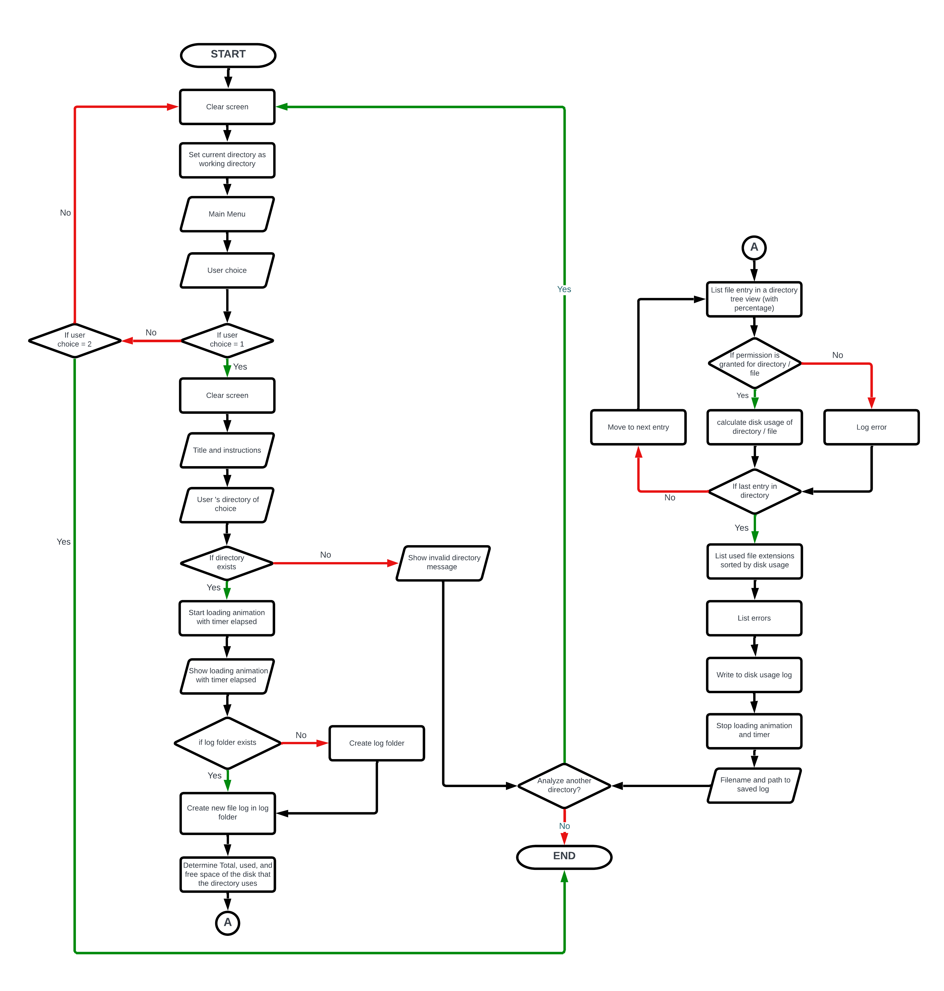
Flowchart

Slide 4
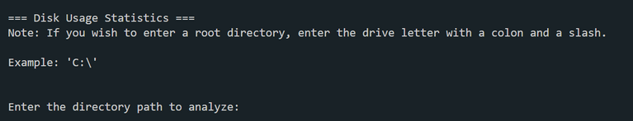
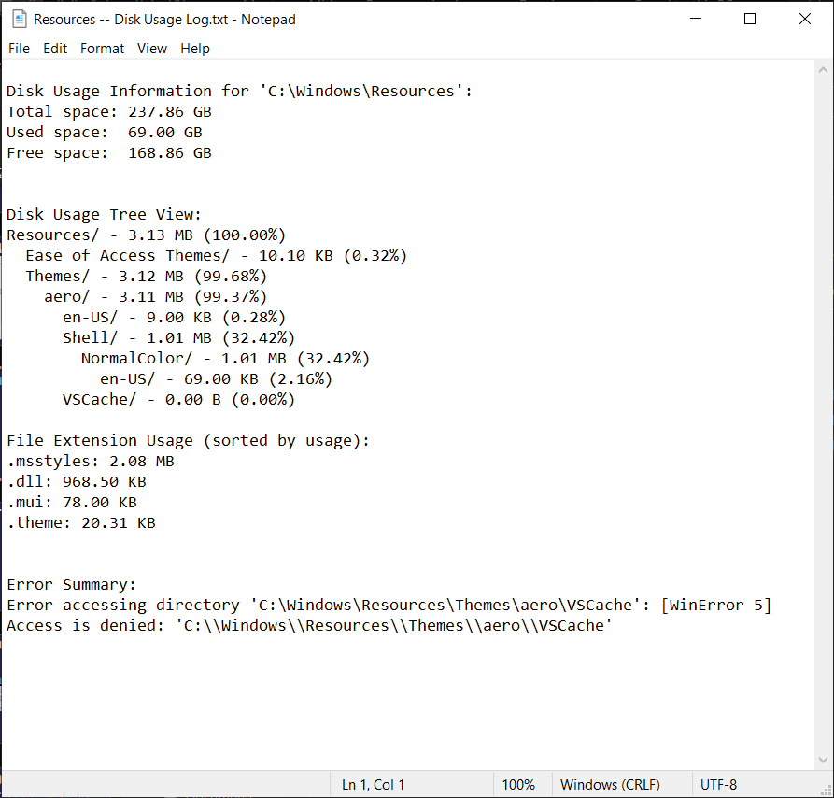
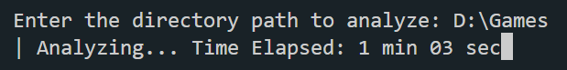
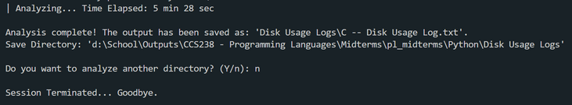
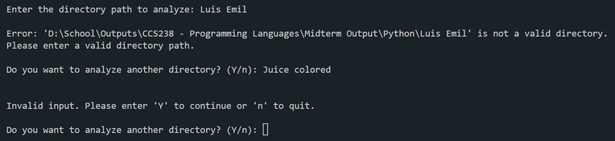
Solution 1: Python
Start
Result
Running
Completed
Error handling

Slide 5
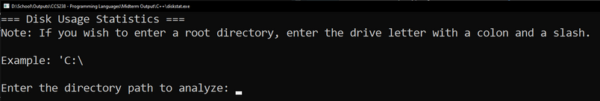
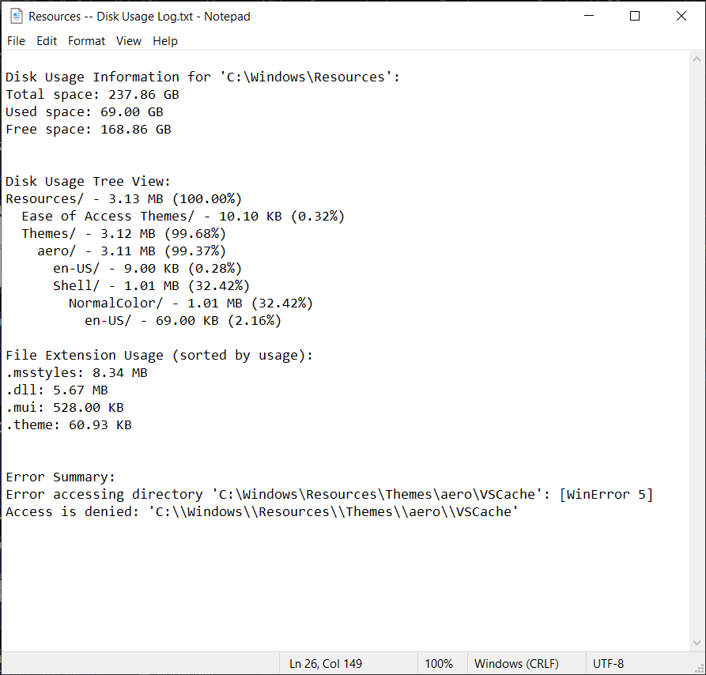
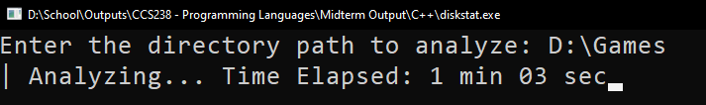
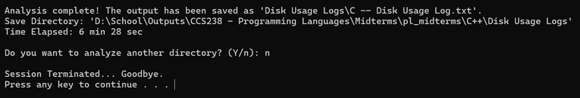
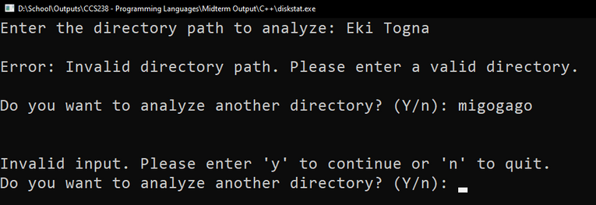
Solution 2: C++
Start
Result
Running
Completed
Error handling

Slide 6


Summary
Python
C++
PYTHON RUNTIME
Disk Type | Filesystem | Size | Runtime
SSD | NTFS | 58GB | 4 mins 27 seconds
SSD | NTFS | 91GB | 7 mins 45 seconds
HDD | NTFS | 778GB | 5 mins 14 seconds
SDXC | exFAT | 67GB | 1 min 26 seconds
C++ RUNTIME
Disk Type | Filesystem | Size | Runtime
SSD | NTFS | 58GB | 5 mins 49 seconds
SSD | NTFS | 91GB | 8 mins 06 seconds
HDD | NTFS | 778GB | 6 mins 34 seconds
SDXC | exFAT | 67GB | 1 min 59 seconds

Slide 7
Conclusion
Python’s syntax is easier to understand due to higher-level abstractions and dynamic typing; ultimately, leading to faster development time. Furthermore, the abundance of libraries that combine optimization and ease of use makes this the preferred choice for small-scale programs like this.
However, if this program was to have more features that would increase its complexity. It will require the highest possible performance and fine-grained control over memory management and the gap in performance will be big and in favor of C++. The only drawback is to commit to its syntax despite the learning curve.

